Slide 1
Cohesion Policy support to European Islands
By Eleftherios Stavropoulos
DG REGIO
Public hearing organised by the Network of the Insular Chambers of Commerce and Industry of the EU (INSULER) in partnership with the European Economic and Social Committee and the European Small Islands Federation (ESIN)
"Entrepreneurship on European Islands"
Brussels – EESC 2 June 10.00-13.00

Slide 2
Cohesion Policy is an investment policy that aims to reinforce economic, social and territorial cohesion in all regions based on strong multi-level governance arrangements in partnership with regions and their citizens at its core.
In 2014-2020 instead of developing compensation schemes for handicaps, we chose to invest in all territories (islands included) and help to develop their comparative and competitive advantages.

Slide 3
Cohesion Policy for 2014-2020 offers many possibilities for supporting and strengthening the development of islands. In implementing Article 174 of the TFEU, the Common Provisions Regulation (EU) No. 1303/2013 ("CPR") stipulates (Article 10 and Annex I on the Common Strategic Framework that Member States shall take account of geographic or demographic features and take steps to address the specific territorial challenges of each region to unlock their specific development potential, thereby also helping them to achieve smart, sustainable and inclusive growth in the most efficient way. This was already taken into account during the negotiations with all the Member States.

Slide 4
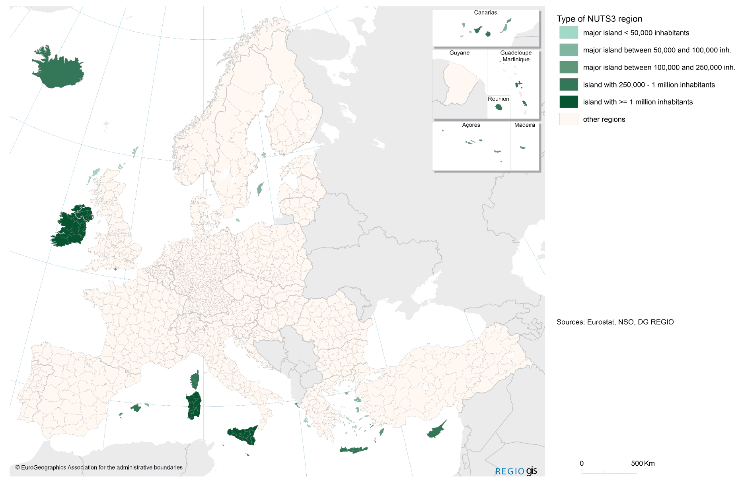

Slide 5
Many islands benefit from derogation to the thematic concentration requirements under the ERDF and have more flexibility to determine investments taking into account their needs, accruing to Articles 4, 10 of the Regulation (EU) No 1301/2013 on the European Regional Development Fund (ERDF) and Article 121 of the CPR. The specific needs are reflected in the current approach where many of the islands are classified as part of a less developed region and as such benefit from the most favourable treatment regarding support from the ESI Funds.

Slide 6
Article 121 of the Common Provisions Regulation also mentions that the co-financing rate from the funds to a priority axis may be adjusted to take account of, amongst others, island Member States eligible under the Cohesion Fund, and other islands, except those on which the capital of a Member State is situated, or which have a fixed link to the mainland.

Slide 7
In addition, regarding cross-border, transnational and inter-regional cooperation under the ERDF, the CPR mentions that Member States and regions shall seek to draw on cross-border and transnational cooperation to: (a) ensure that areas that share major geographical features (islands, lakes, rivers, sea basins or mountain ranges) support the joint management and promotion of their natural resources.
EGTC regulation (1302/2013) for local and regional authorities allows the islands of various Member States and non-Member States to create a joint legal entity enabling them to pursue a common goal and to give them access to EU funding, while lightening the administrative burden that such cooperation would normally entail;

Slide 8
Moreover, in order to recognise the challenges posed by the situation of island Member States and the remoteness of certain parts of the Union, Malta and Cyprus received during MFF negotiations an additional envelope of EUR 150.000.000 and EUR 200.000.000 respectively.
The method for allocating ESI funding in the programming period 2014-2020 allowed to take account of the specificities of the local context. The CPR also refers to many different criteria, which do not only comprise GDP per head, but also population, employment and unemployment rates, as well as educational attainment levels (see annex VII of the aforementioned regulation).
Notes:
South Aegean in Greece benefited from an extra financing that was given to the more developed regions of Greece (Attiki and South Aegean during the last phase of the MFF Negotiations)

Slide 9
The 2014-2020 Regulations have introduced tools (Integrated Territorial Investment and Community-led local development) to support integrated territorial development strategies. The Commission encouraged Member States and regions to use these tools to support local specificities i.e. in islands and to address the specific local needs. i.e. in Germany we have strategies targeting the islands of Amrum and Helgoland in North Sea
Integrated strategies could be targeting entrepreneurial issues on islands for example
Notes:
One impressive example from the mapping of the integrated strategies shows that even in MS that are not the "usual suspects" for island specificities like Germany.
Something that shows that where there is vision the regulations for 2014-2020 allowed for targeted action.

Slide 10
The Cohesion Policy CPR provided the framework for all funds to help the islands:
a) I.e. the European Maritime and Fisheries Fund (EMFF), operations implemented in remote Greek islands and in the Croatian islands of Dugi Otok, Vis, Mljet and Lastovo, may benefit from an increase of 35% of public aid intensity over the general rule of 50%.
b) Through rural development programmes, EAFRD assists islands suffering from natural, demographic and economic disadvantages via investment measures, support for diversifying economic activities, support for knowledge transfer and information actions, and by compensating farmers for natural and other specific constraints (`ANC` payments). Rural development programs may give higher aid intensity - up to 75% - for investments in less developed regions, outermost regions, and on smaller Aegean island both in agriculture and forestry.
c) In order to mitigate the specific constraints resulting from the level of development, the remoteness and insularity, EAFRD contributions can go up to 85 % of the eligible public expenditure in less developed regions, in outermost regions and in the smaller Aegean islands, within the meaning of Regulation (EU) No 229/2013.

Slide 11
Islands face considerable challenges. However, we see more opportunities for islands as generators for energy, testing ground for modern technologies in renewable energy, production of pharmaceutical products from local plants, aqua farming, sea technology etc. Smart Specialisation Strategies and the entrepreneurial discovery shows that there is a lot of potential in islands and not just tourism and residential services

Slide 12
The degree to which the CPR facilities may be taken up depends first and foremost on the national and regional authorities.

Slide 13
DG REGIO is fostering tools such as territorial impact analysis (TIA) and impacts on islands are considered when assessing European policies (i.e. n Revision of Directive 2000/59/EC on Port Reception Facilities)

Slide 14
Post 2020 Cohesion Policy
Broad timetable of the MFF/Post-2020
The impact assessment to prepare the legislative proposals for the post-2020 period should be prepared prior to the next MFF legislative proposals. Preparations will include a public consultation. (Exact timing is not yet clear.)
The Cohesion Forum that will take place end of June 2017 in particular, will allow us to discuss elements of cohesion policy in post 2020 in more depth.
The publication of the 2017 Cohesion Report is planned for September 2017.
Adoption of the legislative proposals will follow the MFF proposal (for 2018).
Political discussions on the future of cohesion policy are also likely to be discussed at a number of other occasions, such as:
Informal Ministerial meeting on cohesion policy – 8/9 June in Malta
European Parliament plenary session on post-2020 – 3-6 July

Slide 15
Post 2020 Cohesion Policy
White Paper on the Future of Europe.
Brexit
Reflections should be driven by strong evidence and in depth consultation with stakeholders
An inclusive process open to new ideas
lessons learned from the ex post evaluation of 2007-2013 programmes early findings from implementation of the new legal framework.

Slide 16
THANK YOU FOR YOUR ATTENTION elftherios:stqvropoulos@ec.europa.eu
Notes:
16

